Slide 1

FYP mid-term presentation
School of Engineering
Supervisor: Mr. Leong Kuan Jeet
By: Muhammad Hanafi Bin Mokhri (155893X)
Module: Electronics, Computer & Communications Engineering

Slide 2
Table of Contents
Project overview
Project Hardware & Software
Task Completed
Problems encountered
Gantt chart

Slide 3
Project overview
A smart door that can make doors work smarter by allowing the user to lock, unlock, close and open doors without being at the door.

Slide 4
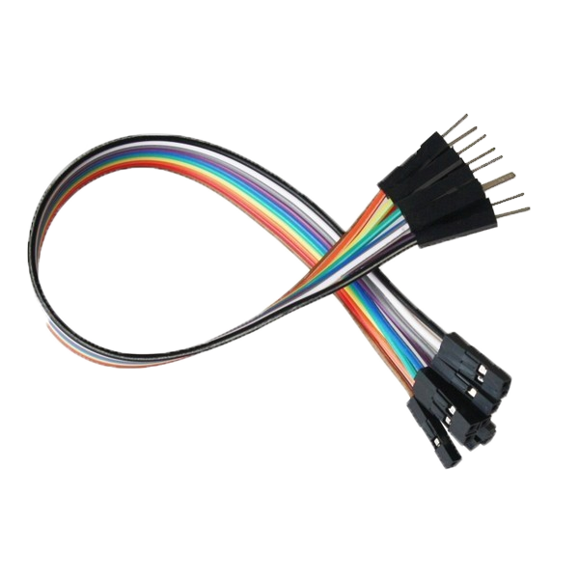
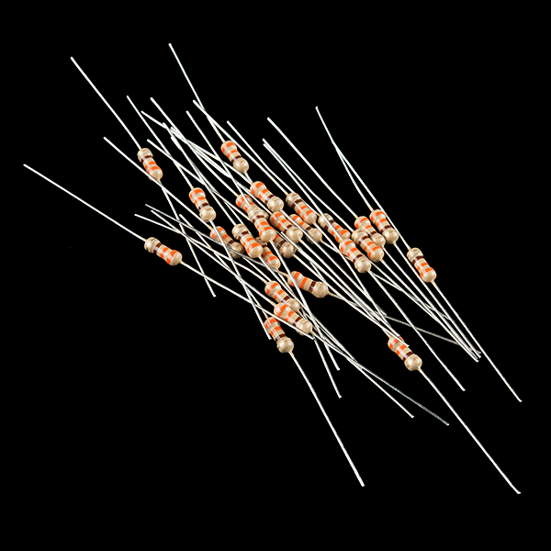
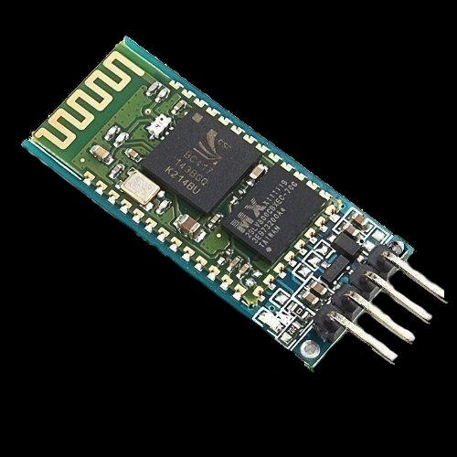
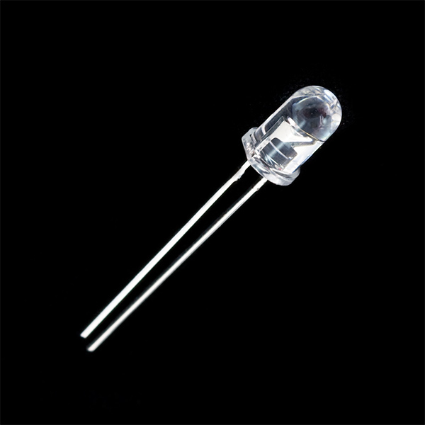

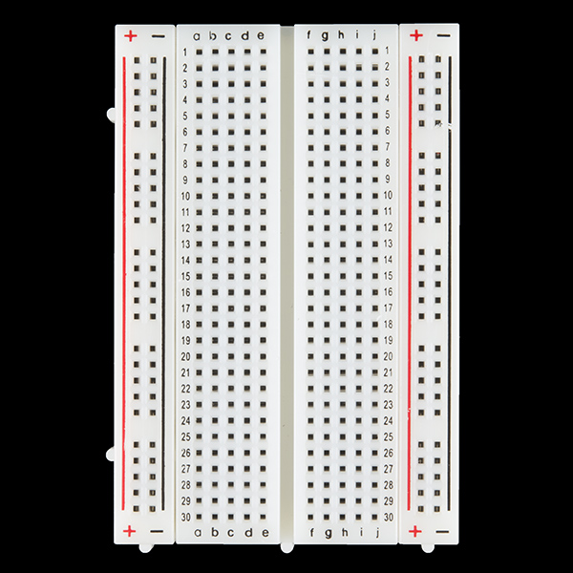
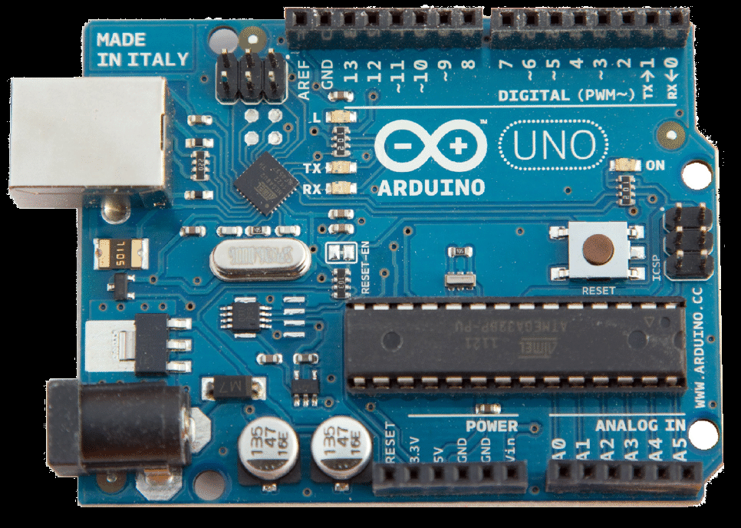
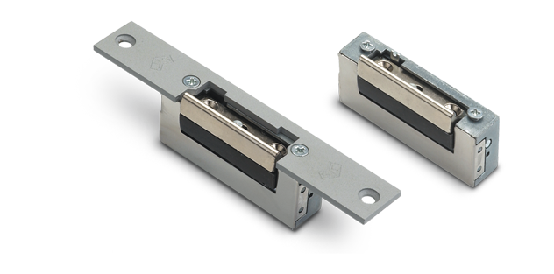
Hardware
Arduino UNO board x 1
Wires
Breadboard
LED lights
Door latch
Assortment of resistors
Bluetooth module
(HC-06 and ARF7044A)
Smartphone

Slide 5
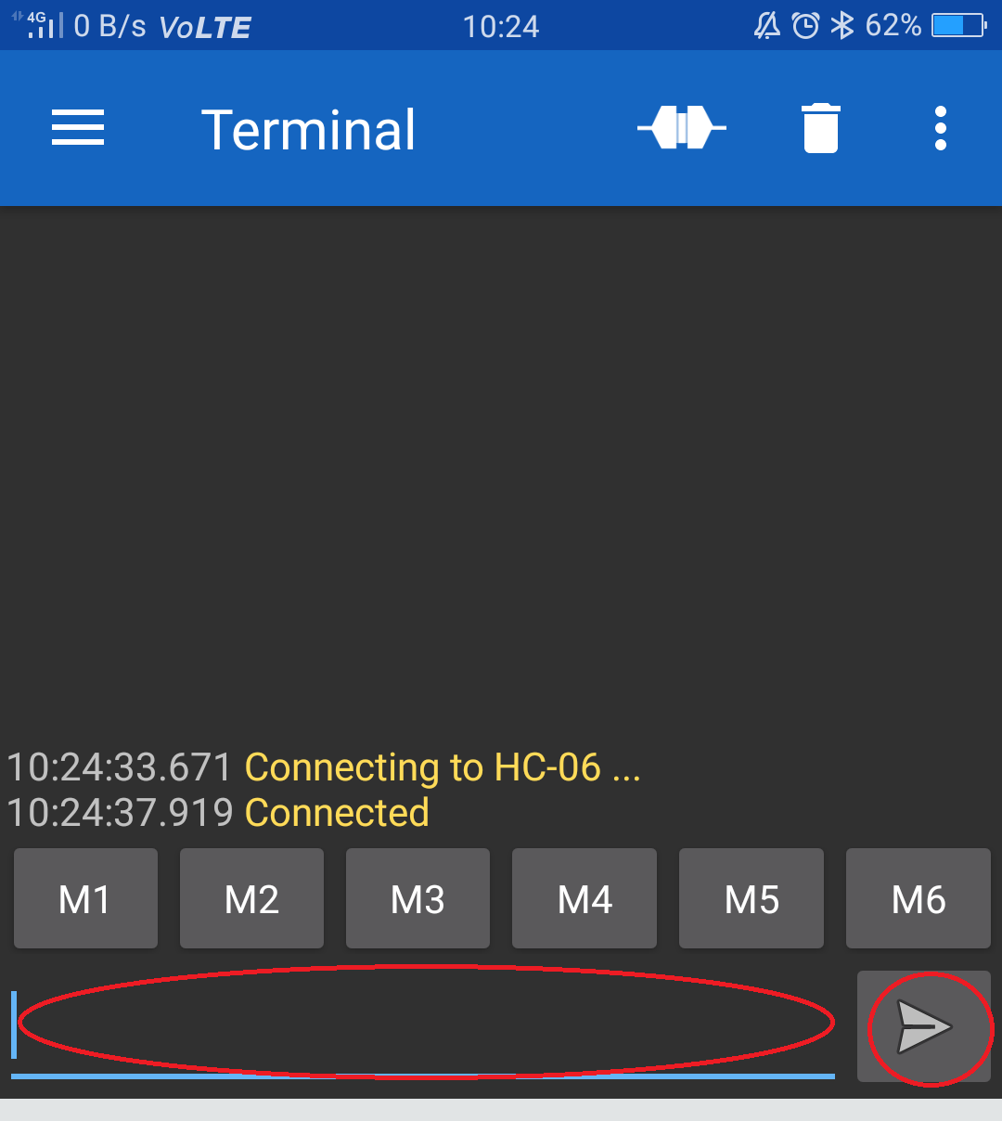
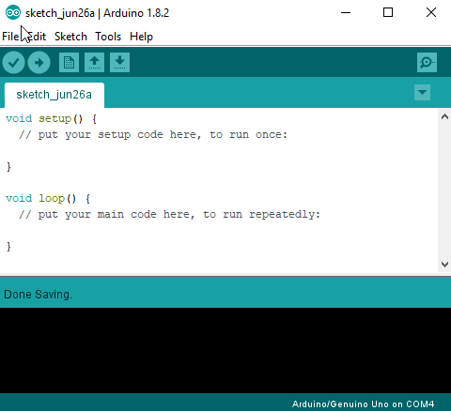
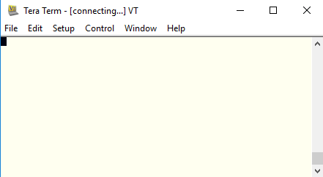
Software
Arduino IDE
Tera Term
Serial Bluetooth Terminal

Slide 6
Project execution (Part 2)
Week 3
A lot of research was done during week 1, mainly re-learning arduino and how it works in general as it’s been a long time since I programmed an arduino board.
Week 4
After week 1 was over and a “foundation” was attained, I tried some simple codes to test the waters. Once I got the gist of it, I tried to communicate between arduino and bluetooth and it worked.

Slide 7
Tasks completed
Research on Arduino and Bluetooth in general
Testing simple Arduino codes
Making a simple bluetooth-controlled LED which will be replaced by a door latch.

Slide 8
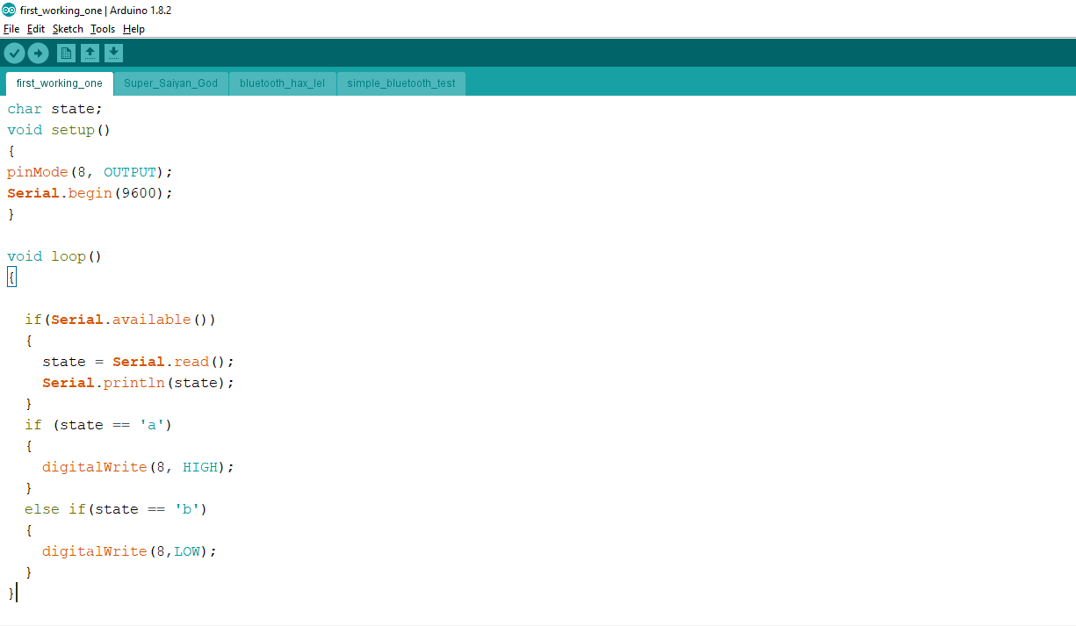
Bluetooth LED controller code

Slide 9
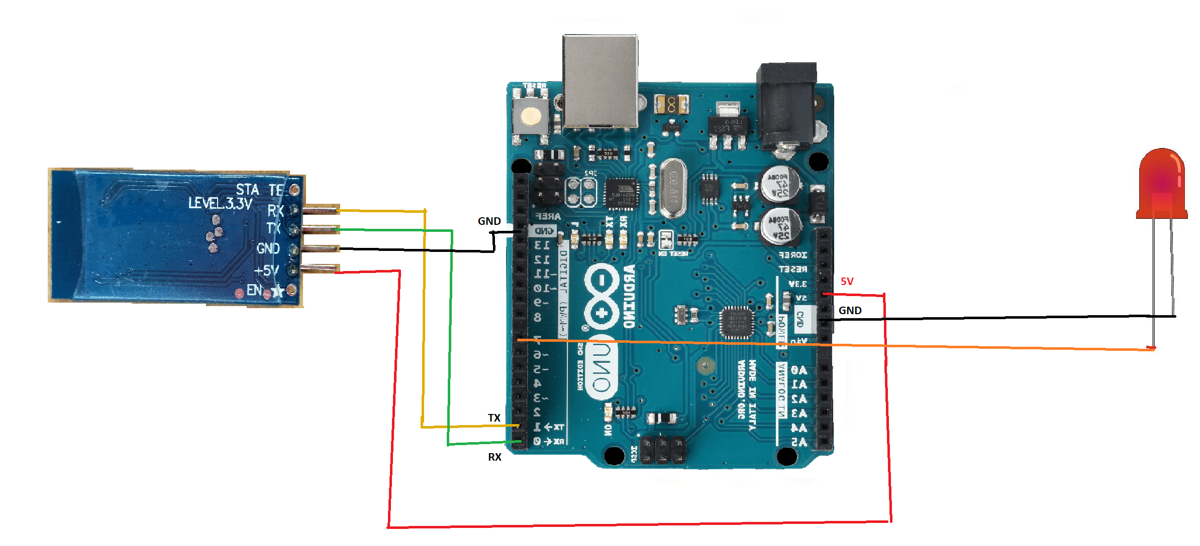
Bluetooth module schematic
Original circuit

Slide 10
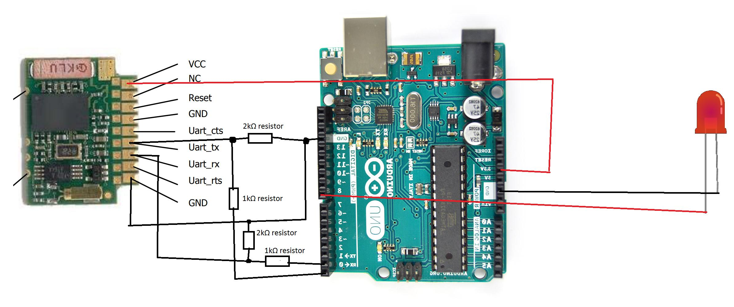
Bluetooth module schematic
Second circuit

Slide 11
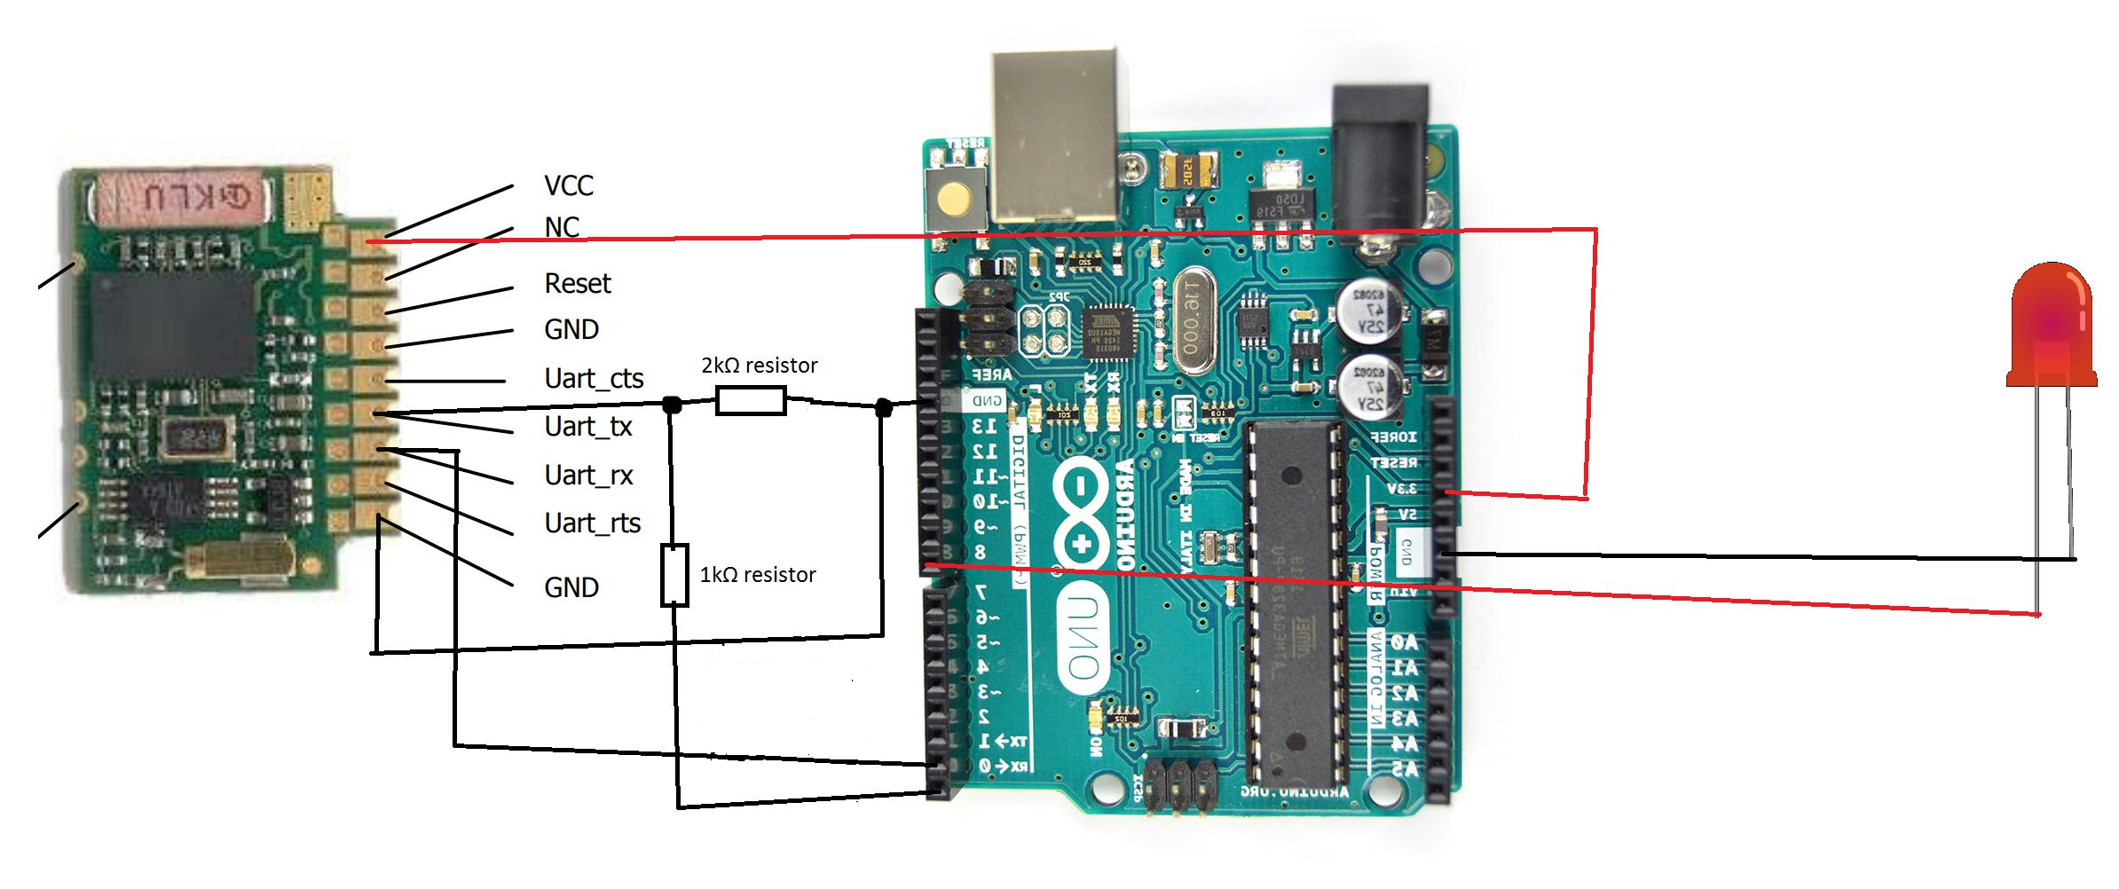
Bluetooth module schematic
Third circuit

Slide 12
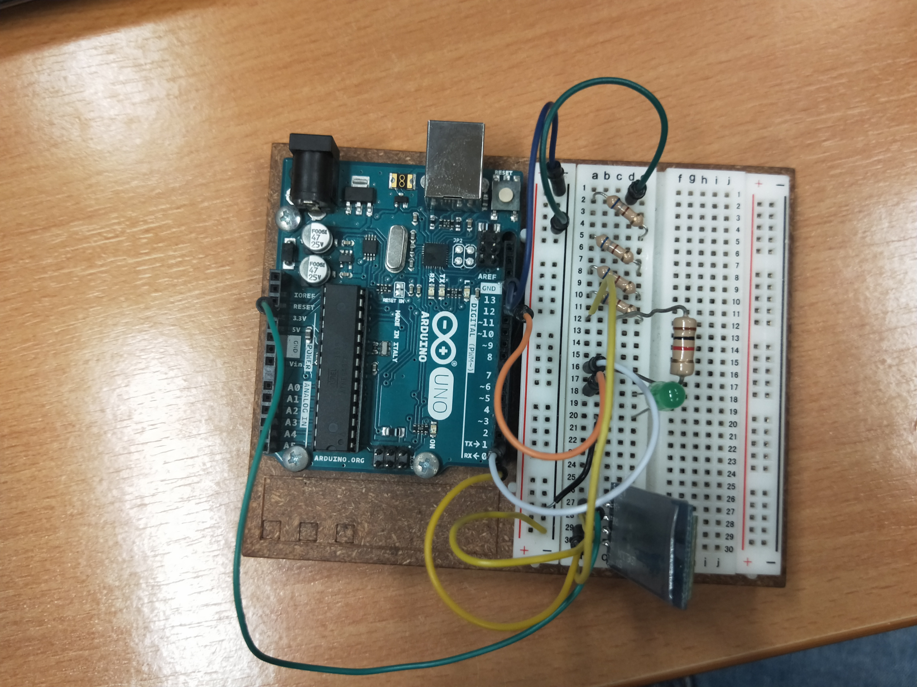
Tasks completed (continued)

Slide 13
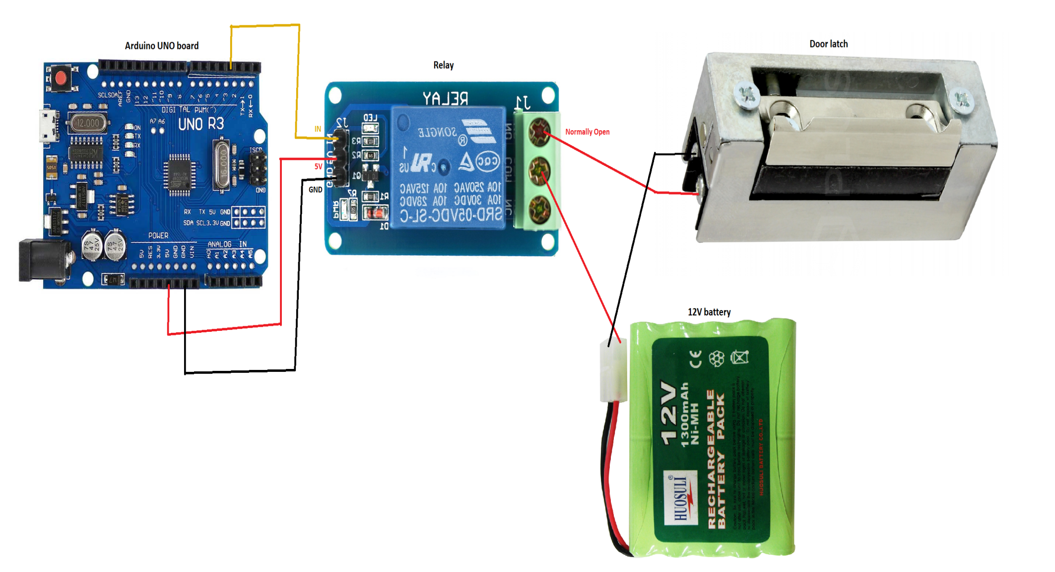
Schematic for door latch and relay

Slide 14
Problems faced
The bluetooth stopped working.
With another bluetooth module, it could tranceive data but couldn’t receive data.
LED stopped working.
The code for the “bluetooth with passcode” doesn’t work

Slide 15
Gantt chart
Week Task name | 1 |  |  |  |  | 2 |  |  |  |  | 3 |  |  |  |  | 4 |  |  |  |  | 5 |  |  |  |  | 6
Research and familiarising with arduino
Testing arduino with simple codes
Making a simple bluetooth-controlled door
Implementing a passcode to lock and unlock the door
planned
actual

Slide 16
Future implementation
An automatic door unlocker when the bluetooth is in range. May not even be bluetooth could be wifi or zigbee.
-can be disabled in settings
Sensors like fingerprint sensor and facial recognition can be implemented.
An anti-burglar door system which alerts the user/police when someone tries to break/pick the lock.

